Slide 1
Energy Transformation and Food

Slide 2
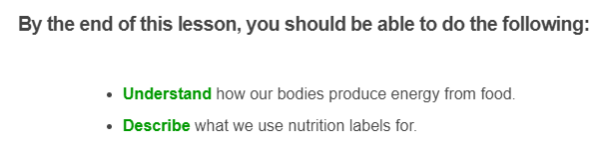


Slide 3

Food stores chemical potential energy.
There is an energy molecule called glucose in food. Our bodies use oxygen and glucose to produce energy in a process called cellular respiration.
Carbon dioxide and water are also produced in this process.

Slide 4
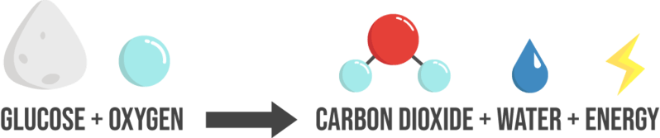
We can write the process of cellular respiration as a word equation:
This helps us visualise what is happening when we consume food for energy!

Slide 5
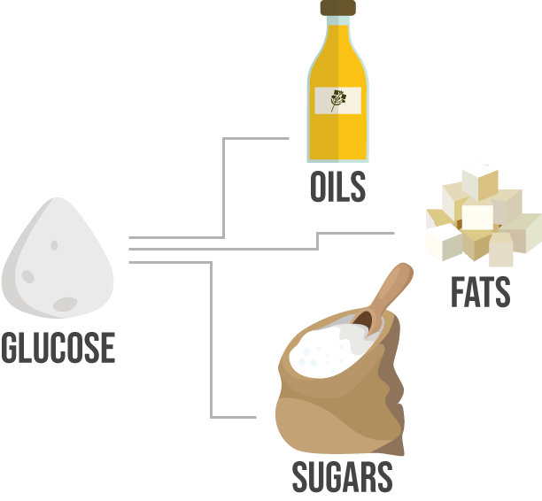
Glucose comes from food chemicals like oils, sugars and fats.
We transform the chemical potential energy from food into kinetic energy and heat energy.
This is how we stay warm and move around!

Slide 6
We use nutrition information panels to see how much energy our food has.
This is an example of a nutrition information panel. We can get lots of important information this. For example, we can see that in each serving there is 33 calories!

Slide 7

By looking at nutrition information panels we can make better food choices.
If we eat a lot of energy-packed food like lollies and fizzy drink, we often go over our recommended daily intake but still feel hungry!
If we instead try and eat a balanced selection of food, we can fuel our bodies for longer on less.

